Slide 1
Shawshank Redemption
What do you believe motivates the human spirit to survive adversity?

Slide 2
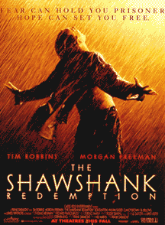

Slide 3
What is the film about?
THEME - the liberating, redemptive power of hope
a patiently-told, allegorical tale
like a long-played, sometimes painstaking, persistent chess game
SUBJECTS =
friendship,
patience,
hope,
survival,
emancipation,
redemption
salvation.

Slide 4
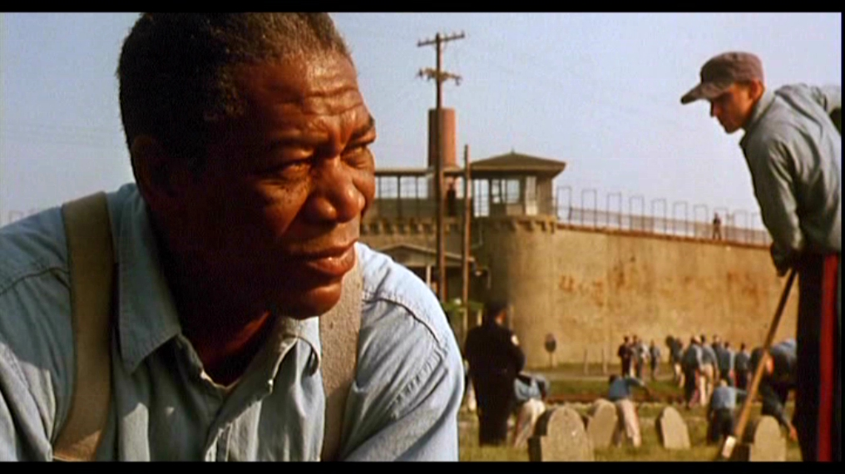
Red – Morgan Freeman

Slide 5
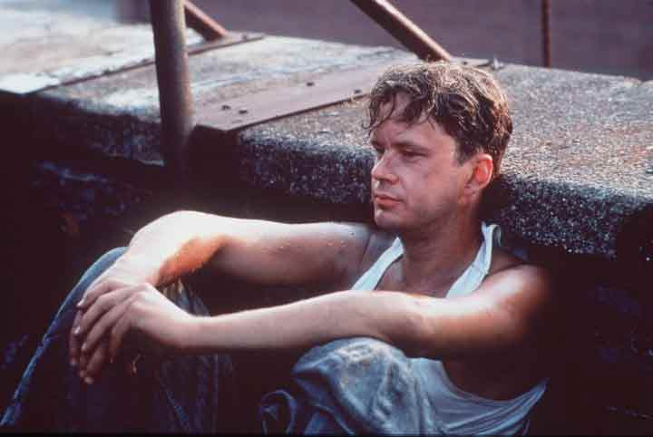
Andy Dufresne = Tim Robbins

Slide 6
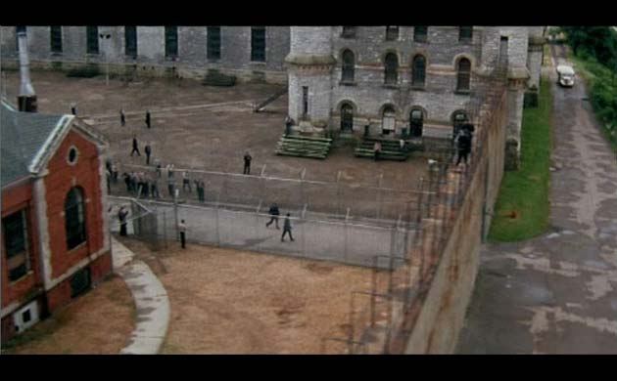
Shawshank Prison

Slide 7
REDEMPTION
Redeem = “to free from whatever distresses or harms”
To recover
To convert
To make amends for
To fulfill (a pledge, a promise)
To obtain release from captivity
to deliver from sin and its consequences by means of a sacrifice offered of the sinner.

Slide 8
Institutionalized
1st = you hate the walls
2nd = you get used to the wall
3rd = you can’t live without the walls – you come to depend on them
“In here he is educated and respected; out there he is just an old con with arthritic hands.”

Slide 11
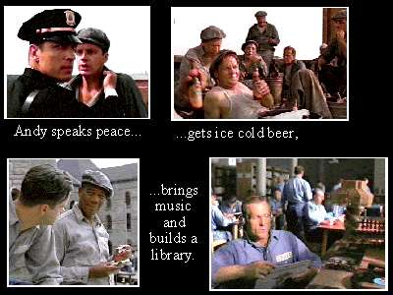

Slide 12
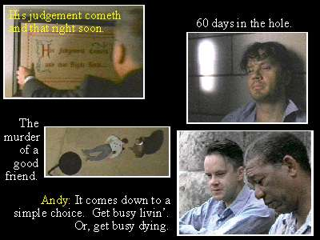

Slide 13
